Slide 1
Note: All slides use Huawei fonts - Huawei Sans & Manrope. Please ensure you have Huawei fonts installed in your laptop. (Access via https://onebox.huawei.com/p/366ee778fe2273154a9cb3269e701123) Otherwise, the slides content would be completely out of place.

Slide 2




Seeds for the Future, Inspiring global talent to shape the future
2008
137
189
12,413
2021
First launched in Thailand
Countries & regions
Endorsement from senior officials and heads of state
Students had benefited from the program
The 1st Tech4Good Global Competition
The longest historical and highest-invested Huawei flagship CSR program. The online version is available since 2020. the first Tech4Good Global Competition began in 2021.
10+ years nurturing top talent. Inspiring the next generation of leaders through technology innovation and cross cultural exchange.

Slide 3
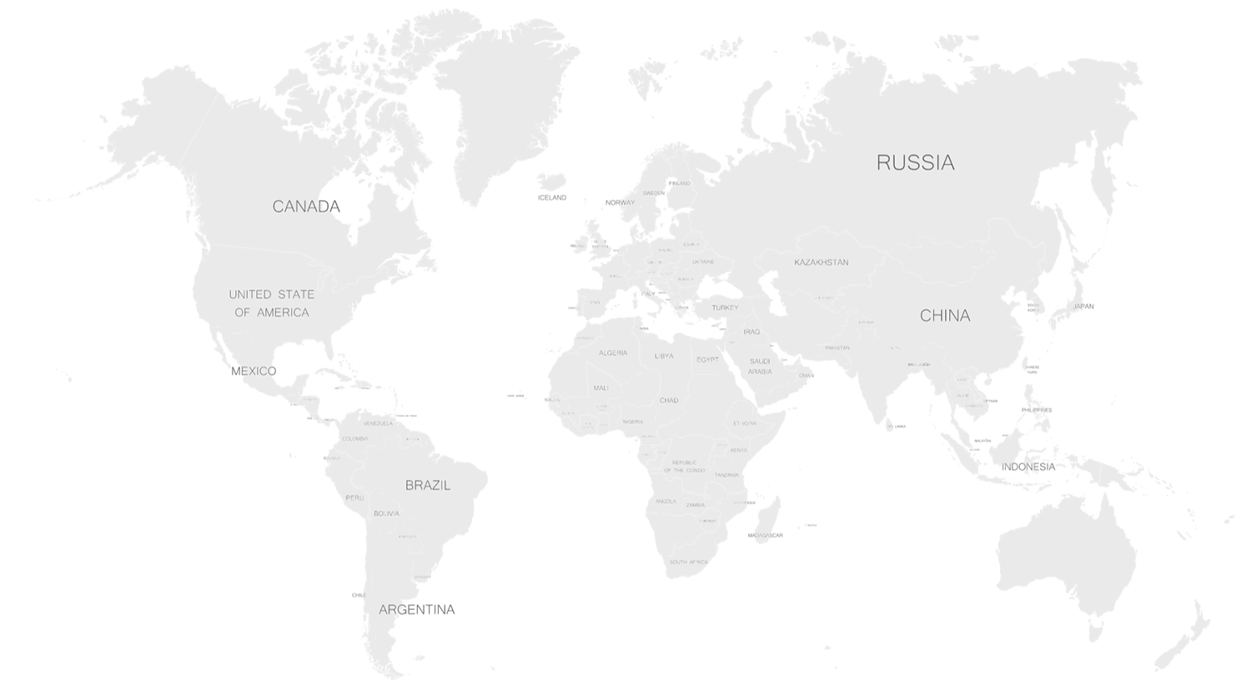
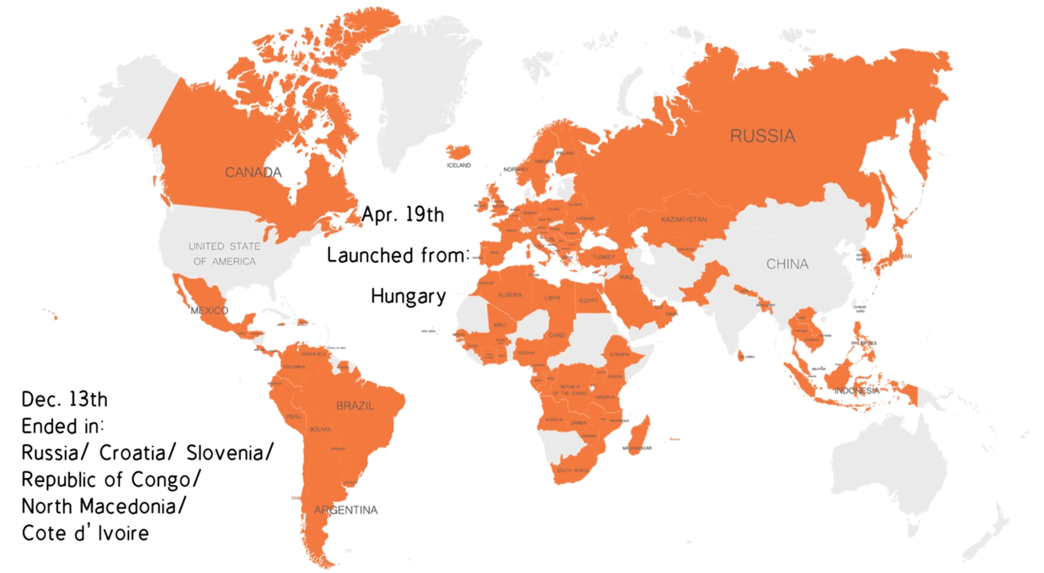
3500+ Seeds participants from 118 countries joined in 2021
In 2021, graduation rate 73%; female participation rate: 37%, including 100% female rate countries – Ghana, Suriname, and Slovenia.
A total of 1352 stakeholders attended Seeds events, triggering 4000+ Seeds for the Future related media reports globally.
2021 Seeds Summary Video
Notes:
纟

Slide 4




Seeds for the Future 2022: Inspiring the next generation of leaders through technology innovation and cross cultural exchange
Alumni Community
Official Website
Online Program
Tech4Good
时习知
All info in one site
8 Day Learning Journey
Tech4Good group project and global competition
The social network of Seeds alumni
Easy to introduce the program during the campus promotion
Outstanding Seeds alumni will be presented on the website
Free access to various topics pre-recorded courses on iLearningX; Experts address questions within 24 hours
Thematic livestream session every day
Tech4Good group project in weekly classes
Global Competition is open to every participant in 2022
International elite network
Professional and appealing content exchange
Exclusive online & offline alumni activities
Public Window
Broaden Horizon
Realize Your Idea
Consensus Building
https://www.huawei.com/minisite/seeds-for-the-future/index.html
https://ilearningx.huawei.com/portal/subportal/SeedsfortheFuture_PR/182
https://www.huawei.com/minisite/seeds-for-the-future/community.html
https://www.linkedin.com/groups/6787709/

Slide 5
What’s new in 2022?
Coach share the contact and provide 1H guidance every day in the program
Monthly online workshop to all seeds throughout the year
Winning team of class will receive 1 month training before the competition
“Tech4Good” Group Project
Group Leader Incentive
Spirit of the team: assistant of the class, lead and inspire the team
Unique reward : small souvenir, special leadership report
New Topics
Tech Enterprise live visit and talk
Hot topic: Metaverse, Digital Power, Z era

Slide 6
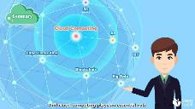
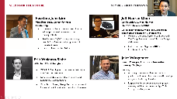
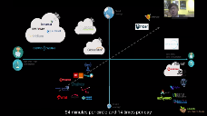
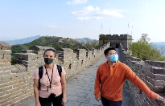
Curriculum's topics focus on students interests and personal development
Pre-recorded Courses
Live-stream Courses
Technology
Leadership & Career Development
Hot Topics
Traditional and Modern China
Entry level and advanced courses in 5G, AI, Cloud,
Kunpeng System, IoT, data, Smart City, Smarthome, etc.
Sustainability and Business Leadership,
Strategic Leadership,
HUAWEI Executive Q&A
Cyber security,
China social media,
Double 11
Metaverse
Live and interactive visit to the Great Wall and other sites,
Modern Chinese life style

Slide 7
How to Participate
Target Audience
Application Materials
Selection process
Outstanding undergraduates/ graduates from top universities
GPA 3.0 or above, or ranking in the top 30% in the faculty
Have strong interest in ICT industry ,entrepreneurship and cross cultural exchange, and great enthusiasm for learning
A resume
A transcript that proofs academic records
A cover letter and/or a 3-minute personal video which reflects objective to participate, interest in ICT, entrepreneurship and China, and enthusiasm for learning
Other materials based on local expectations
Initial screening:
Rep office select eligible students based on their application materials working with local stakeholders
Online interview:
Rep offices are also strongly encouraged to have formal online interviews with candidates following an initial screening of applicants.
Notes:
亚太流程风险国家

Slide 8






Agenda Design
8-day online program: 3 hours of mandatory pre-recorded courses + 15 hours of live-stream courses + “Tech4Good” Group Project + access to all elective courses resources + leadership practice from the beginning to the end
Day 1
Day 2
Day 3
Day 4
Day 5
Weekend
Day 8
Morning check-in (10Mins)
Morning check-in (10Mins)
Morning check-in (10Mins)
Morning check-in (10Mins)
Kick Off:
Program Intro &
Grouping
(1H)
Cross Cultural Exchange (30Mins)
Self-learning
Q&A (1H)
LIVE
Leadership
(2H)
Thematic Round Table (1.5H)
Huawei Visit &
Tech Talk (2H)
China Insight (1H)
“Tech4Good”
Project Intro (1H)
Mentorship & Group discussion 1H
Mentorship & Group discussion 1H
Mentorship & Group discussion 1H
Mentorship & Group discussion 1H
Mentor Q&A
(Optional 1H)
“Tech4Good”
Group Project Presentation (1H)
Before the program: Local team invite and identify 1 student to present home country culture on Day 5
Mandatory courses :
ICT courses: 5G, AI, Cloud Computing (Entry level), Digital Power
Elective courses:
About Huawei: Who is Huawei, Huawei's flagship store & campus virtual tour
ICT related: IoT, smart home, cyber security, digital trade, smart city, data and industry trends
Leadership: Leadership skills, cross-cultural management, and strategic leadership
Prospectives: Macro-economic policies, semiconductor,aerospace, 3D vision
Traditional and Modern China: Chinese Materials Arts, A Bite of China, Secrets of the Forbidden City, Kunqu opera etc.
PRE-RECORDED

Slide 9

“Tech4Good” Group Project:
How to leverage technology to address social and/or environmental issues
DAY 1: We will have 5-10 students per group and introduce “Tech4Good” guidance materials (1H)
DAY 2- Day 5: Group discussion & Q&A (1 H) with mentors
DAY 8: Each group will be given 5 Mins (elevator pitch) to present their work and another 5 Mins for Q&A with judges (1H)
Key Learning Outcomes
What to expect
Tech4Good Global Competition
Increase social entrepreneurship
Understand current trends on how technology can assist with solving complex global challenges
Build problem solving and leadership skills through team work
Deepen personal mission and sense of social responsibility
“Tech4Good” playbook and toolkit materials will be provided
Mentor will be introduced into groups to provide necessary guidance and address project-related questions and doubts every day
Monthly online workshop after your program
Global competition at the end of 2022
Winning team of each class will be awarded 1 month dedicate mentorship
Top 10 finalists online pre-competition training
Investor meeting for TOP1 team; Cash prize for TOP3 teams, and more (will be updated later)

Slide 10


Graduation
Graduation criteria
Certificate
Pass 4 mandatory courses on iLearningX: 5G, AI, Cloud and Digital Power (Gain 60 scores out of 100 for each)
Attend all live-stream courses
Participate in “Tech4Good” group project
Certificates of Completion & Personal Leadership Report will be awarded (electronic copy).
Rep offices can provide students with other gifts (own discretion)

Slide 11
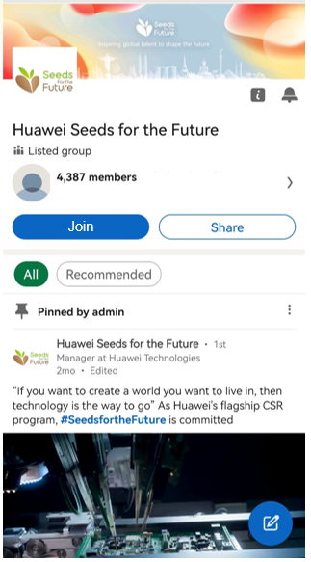
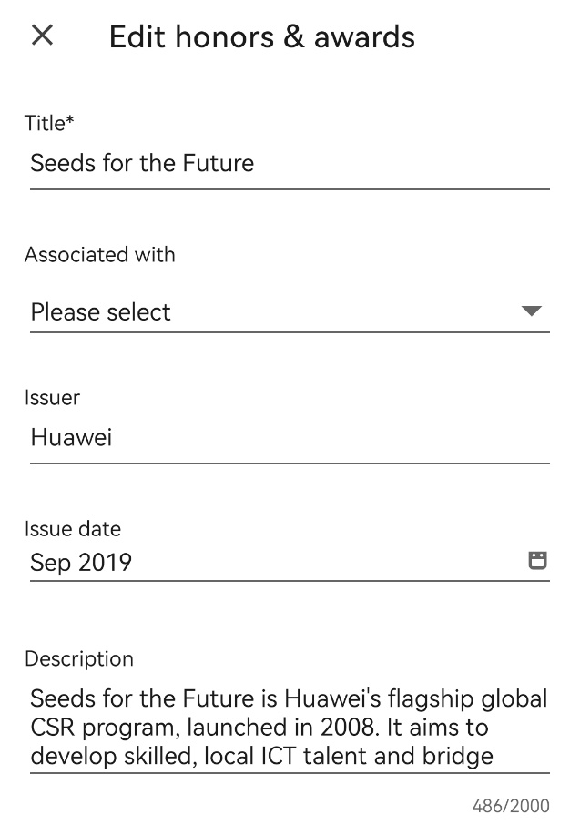
Welcome to SFTF Community : Our Global Family for Seeds Alumna
Find us in LinkedIn
2. Click here to join
4. Join the conversation and the Alumna events!
Alumna & 2022 Participants
Remark year + country
🌱 Seeds Culture
🌱 Seeds Meetup
Slogan:
Who for the Future
Seeds for the Future
Roll Call
Dancing
Local activities
Global Summit
3. Integrate into your profile
Alumna events
🌱 Seeds Focus: Digitalization, Sustainability, Entrepreneurship
What’s new in the Digital World
Shape a sustainable future together
Seeds for the Future is Huawei's flagship global CSR program, launched in 2008. It aims to develop skilled, local ICT talent and bridge communication between countries and cultures. The program requires a minimum learning of 13 hours, covering exclusive courses to learn about Huawei and the latest technologies (5G, AI, cloud computing and HMS), to discover the technology ecosystem in China, to learn form the best experts in the industry and to get a glimpse of the Chinese culture.
The description for you

Slide 12
THANK YOU！

